Slide 1

(10-1) Efficiency of Algorithms
D & D Chapter 20
Instructor - Andrew S. O’Fallon
CptS 122 (October 26, 2015)
Washington State University
Notes:
C. Hundhausen, A. O’Fallon

Slide 2
Analysis of Algorithms (1)
In general, we want…
  to determine central unit of work
  to express unit of work as function of size of input data: How quickly does amount of work grow as size of input grows?
For example, recall Sequential Search algorithm
  Get list of n names to search, and target name to search for
  Examine each name in sequence
    If all names have been examined, set found to false and stop
    If name equals target, set found to true and stop
    If name not equal to target, advance to next name
  Main unit of work: comparisons
  Analysis
    In best case, one comparison must be made (target is first item in list)
    In worst case, n comparisons must be made (target not found; all items examined)
    In average case n/2 comparisons must be made
C. Hundhausen, A. O’Fallon
Notes:
C. Hundhausen, A. O’Fallon

Slide 3
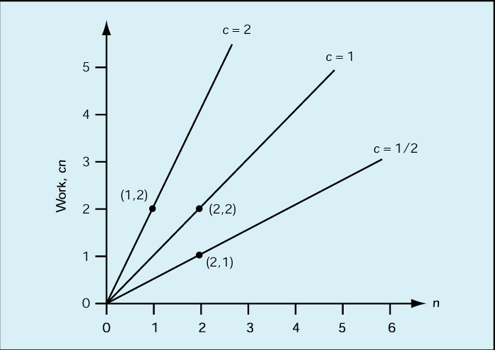
Analysis of Algorithms (2)
Order of magnitude analysis (“Big-O”)
  Constant factors do not change shape of graph!
C. Hundhausen, A. O’Fallon
Notes:
C. Hundhausen, A. O’Fallon

Slide 4
Analysis of Algorithms (3)
Order of magnitude (“Big-O”) (cont.)
  Any algorithm whose work can be expressed as c * n where c is a constant and n is the input size is said to be “order of magnitude n”, or O(n)
  Likewise, any algorithm whose work varies as a constant times the square of the input size is said to be “order of magnitude n-squared”, or O(n²)
C. Hundhausen, A. O’Fallon
Notes:
C. Hundhausen, A. O’Fallon

Slide 5
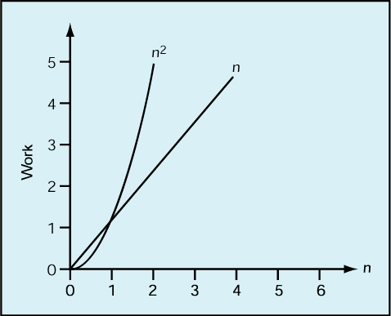
Analysis of Algorithms (4)
Order of magnitude (“Big-O”) (cont.)
  O(n²) always gets bigger than O(n) eventually!
C. Hundhausen, A. O’Fallon
Notes:
C. Hundhausen, A. O’Fallon

Slide 6
Analysis of Algorithms (5)
Big-O Analysis of Sequential Search
  Best case: O(1)
  Worst case: O(n)
  Average case: O(n/2) = O(n)
C. Hundhausen, A. O’Fallon
Notes:
C. Hundhausen, A. O’Fallon

Slide 7
Analysis of Algorithms (6)
Recall Selection Sort…
  Input: a list of numbers
  Output: a list of the same numbers in ascending order
  Method:
    Set marker that divides “unsorted” and “sorted” sections of list to the end of the list
    While the unsorted section of the list is not empty
      Find largest value in “unsorted” section of list
      Swap with last value in “unsorted” section of list
      Move marker left one position
C. Hundhausen, A. O’Fallon
Notes:
C. Hundhausen, A. O’Fallon

Slide 8
Analysis of Algorithms (7)
Selection Sort (cont.)
  Big-O Analysis
    Units of work: comparisons and exchanges
    In all cases, we need n + (n - 1) + … + 1 comparisons = [n * (n – 1)]/2 comparisons = 1/2n² – 1/2n comparisons = O(n²) comparisons
    In best case, items are already in order, so 0 exchanges needed: O(n²) comparisons + 0 exchanges = O(n²)
    In worst case, items are in reverse order, so n exchanges needed: O(n²) comparisons + n exchanges = O(n²)
C. Hundhausen, A. O’Fallon
Notes:
C. Hundhausen, A. O’Fallon

Slide 9
Analysis of Algorithms (8)
Selection Sort (cont.)
  Space Analysis
    Major space requirement is list of numbers (n)
    Other space requirements:
      Extra memory location needed for marker between sorted and unsorted list
      Extra memory location needed to store LargestSoFar used to find largest item in unsorted list
      Extra memory location needed to exchange two values (why?)
      Overall, space requirement is proportional to n.
C. Hundhausen, A. O’Fallon
Notes:
C. Hundhausen, A. O’Fallon

Slide 10
Analysis of Algorithms (9)
Recall Binary Search…
  Input: a list of n sorted values and a target value
  Output: True if target value exists in list and location of target value, false otherwise
  Method:
    Set startindex to 1 and endindex to n
    Set found to false
    While found is false and startindex is less than or equal to endindex
      Set mid to midpoint between startindex and endindex
      If target = item at mid then set found to true
      If target < item then set endindex to mid – 1
      If target > item then set to startindex to mid + 1 pointSet marker that divides “unsorted” and “sorted” sections of list to the end of the list
    If found = true then print “Target found at location mid”
    Else print “Sorry, target value could not be found.”
C. Hundhausen, A. O’Fallon
Notes:
C. Hundhausen, A. O’Fallon

Slide 11
Analysis of Algorithms (10)
Binary Search (cont.)
  Big-O Analysis
    Unit of work: comparisons
    Best case
      target value is at first midpoint
      O(1) comparisons
    Worst case
      target value is not found
      list is cut in half until it is reduced to a list of size 0 (startindex is greater than or equal to endindex)
      How many times can the list be cut in half? The number of times a number n is divisible by another number m is defined to be the logb(a), so the answer is log₂(n) =
      O(lg n)
C. Hundhausen, A. O’Fallon
Notes:
C. Hundhausen, A. O’Fallon

Slide 12
Analysis of Algorithms (11)
 |  | n
Order |  |  | 10 | 50 | 100 | 1000
lg n |  |  | 0.0003 sec | 0.0006 sec | 0.0007 sec | 0.001 sec
n |  |  | 0.001 sec | 0.005 sec | 0.01 sec | 0.1 sec
n² |  |  | 0.01 sec | 0.25 sec | 1 sec | 1.67 min
2^{n} |  |  | 0.1024 sec | 3570 yrs | 4 * 1016 centuries | Too big to compute
C. Hundhausen, A. O’Fallon
Notes:
C. Hundhausen, A. O’Fallon

Slide 13
Summary of Orders of Magnitude
O(lg n) = flying
O(n) = driving
O(n²) = walking
O(n³) = crawling
O(n⁴) = barely moving
O(n⁵) = no visible progress
O(2^{n}) = forget it, it will never happen
C. Hundhausen, A. O’Fallon
Notes:
C. Hundhausen, A. O’Fallon

Slide 14
References
P.J. Deitel & H.M. Deitel, C++ How to Program (9th Ed.), Pearson Education , Inc., 2014.
J.R. Hanly & E.B. Koffman, Problem Solving and Program Design in C (7th Ed.), Addison-Wesley, 2013
C. Hundhausen, A. O’Fallon
Notes:
C. Hundhausen, A. O’Fallon

Slide 15
Collaborators
Chris Hundhausen
C. Hundhausen, A. O’Fallon
Notes:
C. Hundhausen, A. O’Fallon

